Slide 1
React Meetup Hamburg | October 2019 | @nilshartmann
NILS HARTMANN
https://nilshartmann.net
One Year
React Hooks
A (Critical) Review
Slides: https://nils.buzz/react-meetup-hooks

Slide 2

https://nilshartmann.net
NILS HARTMANN
nils@nilshartmann.net
Developer, Architect, Trainer from Hamburg (Freelancer)
JavaScript, TypeScript
React
GraphQL
Java
Trainings, Workshops and Coachings

Slide 3
React Hooks
Anyone NOT knowing what Hooks are?

Slide 4
React Hooks
Anyone NOT knowing what Hooks are?
Hooks 2 Minute intro
add State, Lifecycle, Sideffects in functional components (almost no need for class components anylonger)

Slide 5
React Hooks
Anyone NOT knowing what Hooks are?
Hooks 2 Minute intro
add State, Lifecycle, Sideffects in functional components (almost no need for class components anylonger)
"Hooks into your components lifecycle"

Slide 6
React Hooks
Anyone NOT knowing what Hooks are?
Hooks 2 Minute intro
add State, Lifecycle, Sideffects in functional components (almost no need for class components anylonger)
"Hooks into your components lifecycle"
Regular JavaScript functions...
...but must start with 'use'
...but must not be used in conditionals, for/loops, Class components
...but behaviour is tied to React

Slide 7
React Hooks
Hooks example
import React, { useState } from "react";
export default function SettingsForm(props) {
const [favColor, setFavColor] = useState("blue");
return <•••>
<input value={favColor}
onChange={e => setFavColor(e.target.value) } />
<•••>
}
useState returns value and setter-function
When state changes, component re-renders
component function will run again

Slide 8
React Hooks
One Year of Hooks...
There are some built-in Hooks, like
useState
useReducer handle state in a Redux-like way but only for one component
useEffect for sideeffects (replaces lifecycle methods in classes)
useContext to receive a Context object
useCallback/useMemo/useRef: solve problems that arise due to using... Hooks

Slide 9
React Hooks
One Year of Hooks...
Libraries ship with Hooks, like
Redux (useSelector, useDispatch, useStore)
Router (useHistory, useParams, useLocation)
Apollo Client (useQuery, useMutation)
React Intl (useIntl)
React i18n (useTranslation)
Community has them too,
https://usehooks.com
https://nikgraf.github.io/react-hooks/
https://www.hooks.guide/

Slide 10
Some voices...
React Hooks
Good or Evil?
Notes:
Bevor wir uns mit React beschäftigen, ein kurzer Hintergrund zum Thema Single-Page-Anwendungen.

Slide 11
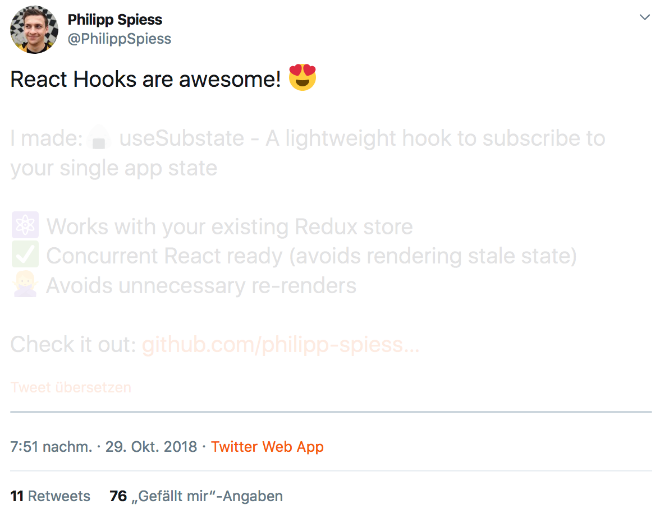
https://twitter.com/philippspiess/status/1056981916489015296
Notes:
Bevor wir uns mit React beschäftigen, ein kurzer Hintergrund zum Thema Single-Page-Anwendungen.

Slide 12
😱
"With Hooks,
React loses its innocence
and becomes Angular"
Attendee of one of my workshops
Notes:
Bevor wir uns mit React beschäftigen, ein kurzer Hintergrund zum Thema Single-Page-Anwendungen.

Slide 13

https://twitter.com/dan_abramov/status/1056808552180793344
Notes:
Bevor wir uns mit React beschäftigen, ein kurzer Hintergrund zum Thema Single-Page-Anwendungen.

Slide 14
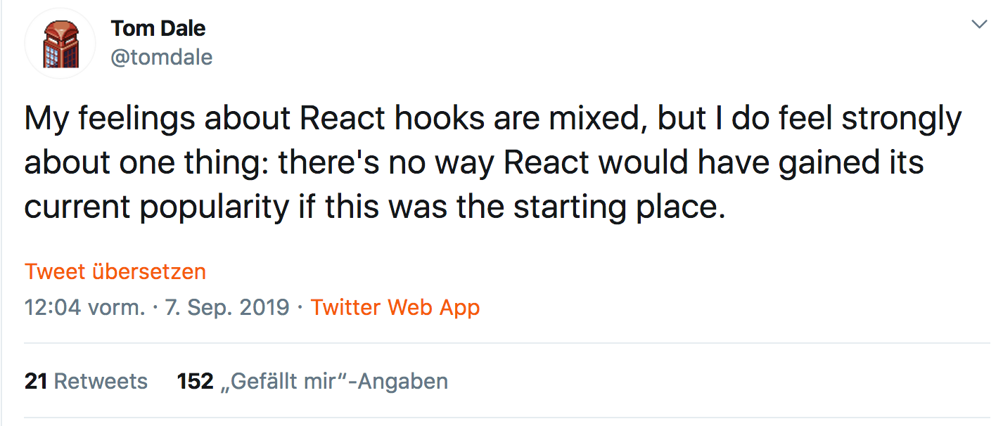
https://twitter.com/tomdale/status/1170095532066430977
Notes:
Bevor wir uns mit React beschäftigen, ein kurzer Hintergrund zum Thema Single-Page-Anwendungen.

Slide 15
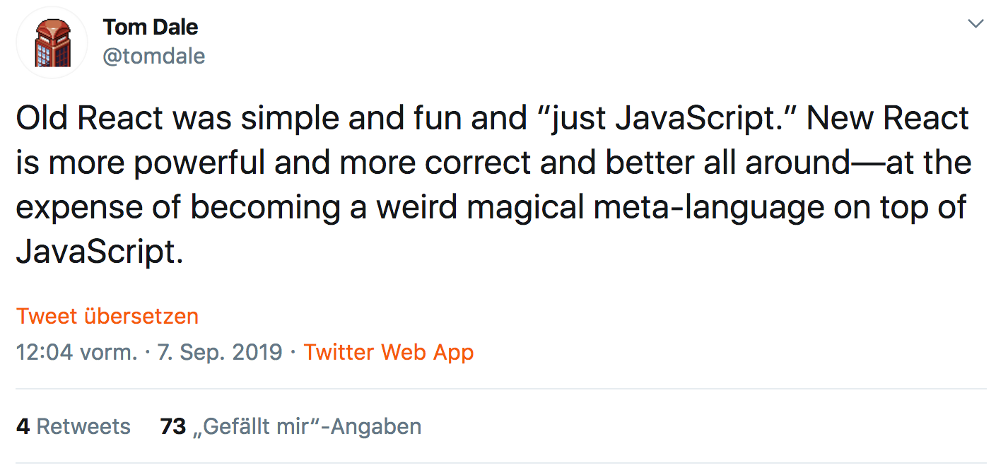
https://twitter.com/tomdale/status/1170095532922064901
Notes:
Bevor wir uns mit React beschäftigen, ein kurzer Hintergrund zum Thema Single-Page-Anwendungen.

Slide 16
why?
"awesome"
"weird"
"mixed feelings"
"angular"
Notes:
Bevor wir uns mit React beschäftigen, ein kurzer Hintergrund zum Thema Single-Page-Anwendungen.

Slide 17
React Hooks
A LOOK AT THE API
Notes:
Bevor wir uns mit React beschäftigen, ein kurzer Hintergrund zum Thema Single-Page-Anwendungen.

Slide 18
A look at the api
useContext to access React Context in your functional component
export default function SettingsForm(props) {
const contextValue = React.useContext(ThemeContext);
return <p>Your context color: {contextValue.color}</p>
}

Slide 19
A look at the api
useContext to access React Context in your functional component
export default function SettingsForm(props) {
const contextValue = React.useContext(ThemeContext);
return <p>Your context color: {contextValue.color}</p>
}
Noteable: This is probably easy to understand: I want to use context "ThemeContext" here in my component

Slide 20
A look at the api
useContext to access React Context in your functional component
export default function SettingsForm(props) {
const contextValue = React.useContext(ThemeContext);
return <p>Your context color: {contextValue.color}</p>
}
Noteable: This is probably easy to understand: I want to use context "ThemeContext" here in my component
But: if context changes, SettingsForm will automatically be re-executed! Why? Because it's a ... Hook ("weird magical meta-language") "Something" happens ins the background to make that work There is no indicator that this will happen. Syntactically "only" JavaScript

Slide 21
A look at the api
useState for local State in your functional component
export default function SettingsForm(props) {
const [ favColor, setFavColor ] = useState("red");
return <input value={favColor}
onChange={e => setFavColor(e.target.value) />
}

Slide 22
A look at the api
useState for local State in your functional component
export default function SettingsForm(props) {
const [ favColor, setFavColor ] = useState("red");
return <input value={favColor}
onChange={e => setFavColor(e.target.value) />
}
Noteable: Return Value
what is this? Tuple! (btw: I think Tuples will make it to JavaScript)
unsual (yet), but elegant, allows to name my variables as I want them to

Slide 23
A look at the api
useState for local State in your functional component
export default function SettingsForm(props) {
const [ favColor, setFavColor ] = useState("red");
return <input value={favColor}
onChange={e => setFavColor(e.target.value) />
}
Noteable: Return Value
what is this? Tuple! (btw: I think Tuples will make it to JavaScript)
unsual (yet), but elegant, allows to name my variables as I want them to
Noteable: initial value, used only once even if this function is run on each render Why? Because it's a ... Hook ("weird magical meta-language")

Slide 24
A look at the api
useState for local State in your functional component
export default function SettingsForm(props) {
const [ favColor, setFavColor ] = useState("red");
return <input value={favColor}
onChange={e => setFavColor(e.target.value) />
}
Noteable: Return Value
what is this? Tuple! (btw: I think Tuples will make it to JavaScript)
unsual (yet), but elegant, allows to name my variables as I want them to
Noteable: initial value, used only once even if this method is run on each render Why? Because it's a ... Hook ("weird magical meta-language")
Noteable: setter-Function leads to re-render Why? Because it's a ... Hook ("weird magical meta-language")

Slide 25
A look at the api
useState another try
export default function SettingsForm(props) {
const [ easy, setEasy ] = useState(true);
function handleClick() {
setEasy(!easy);
console.log(easy);
// what is acutally easy here after first button click? 🤔
}
return <button onClick={handleClick}>Do it</button>
}
Noteable: setting a state is still "defered" or "async" Might or might not be obvious
Credits: https://twitter.com/mjackson/status/1102430168839143424

Slide 26
A look at the api
useEffect for sideeffects
export default function SettingsForm(props) {
useEffect( () => { start(); return () => stop() }, [])
return <...>
}
Noteable: Everything
what is a sideeffect? API call, DOM API, console.log?
what is 2nd argument ("dependency array")
unsual way to "limit" call to functions
btw: what does [] semantically mean? Let's call the experts!

Slide 27
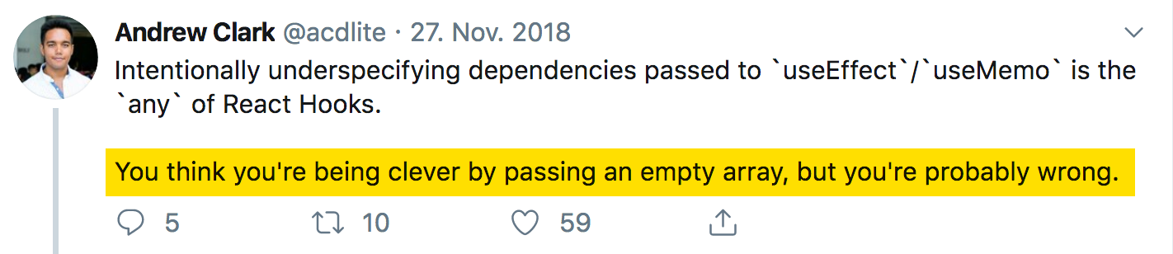
A look at the api
useEffect for sideeffects
https://twitter.com/acdlite/status/1067541310377123840

Slide 28
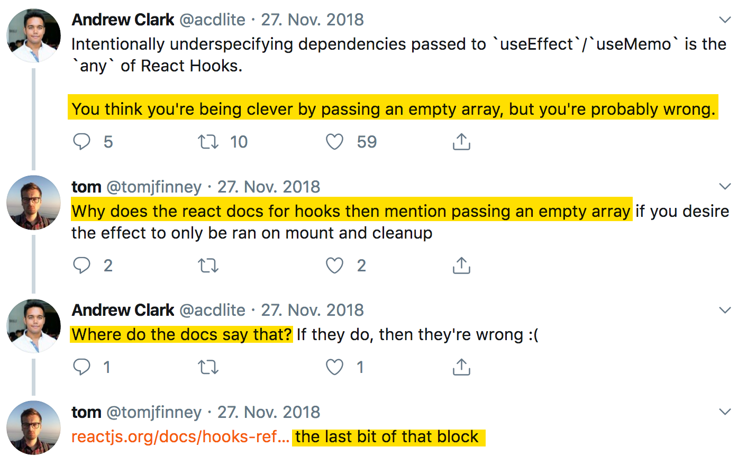
A look at the api
useEffect for sideeffects

Slide 29
A look at the api
useEffect for sideeffects

Slide 30
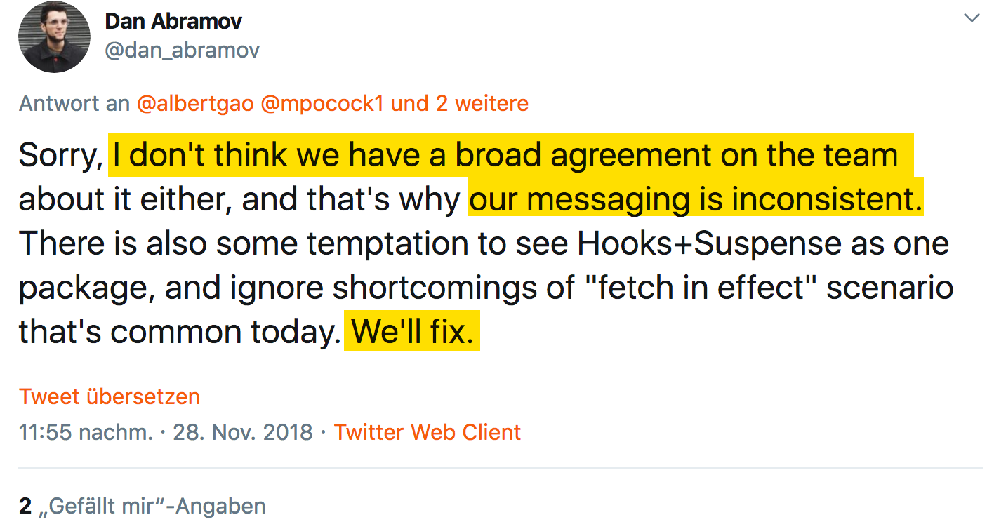
A look at the api
useEffect for sideeffects
https://twitter.com/dan_abramov/status/1067914987753091074

Slide 31
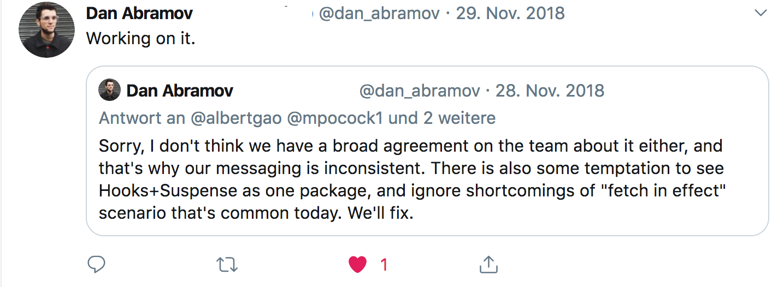
A look at the api
useEffect for sideeffects
https://twitter.com/dan_abramov/status/1067917403709943808?s=20

Slide 32
A look at the api
useEffect for sideeffects
https://twitter.com/dan_abramov/status/1067917403709943808?s=20
- end of thread -

Slide 33
React Hooks
USING HOOKS
Notes:
Bevor wir uns mit React beschäftigen, ein kurzer Hintergrund zum Thema Single-Page-Anwendungen.

Slide 34
Using hooks
Using Hooks: this is simple...
import React, { useState } from "react";
export default function SettingsForm(props) {
const [ favColor, setFavColor ] = useState("blue");
return <input value={favColor} onChange={...} />
}

Slide 35
using hooks
Using Hooks: let's add context...
import React, { useState, useContext } from "react";
export default function SettingsForm(props) {
const login = useContext(LoginContext);
const [ favColor, setFavColor ] = useState("blue");
return <input value={favColor} onChange={...} />
}

Slide 36
using hooks
Using Hooks: and now... boom!
import React, { useState, useContext } from "react";
export default function SettingsForm(props) {
const login = useContext(LoginContext);
if (login.loggedIn) {
return <Redirect to="/login" />
}
const [ favColor, setFavColor ] = useState("blue");
return <input value={favColor} onChange={...} />
}

Slide 37
using hooks
Using Hooks: and now... boom!
import React, { useState, useContext } from "react";
export default function SettingsForm(props) {
const login = useContext(LoginContext);
if (login.loggedIn) {
return <Redirect to="/login" />
}
const [ favColor, setFavColor ] = useState("blue");
return <input value={favColor} onChange={...} />
}
Why? Because it's a ... Hook ("weird magical meta-language") Hooks must always be called in the same order

Slide 38
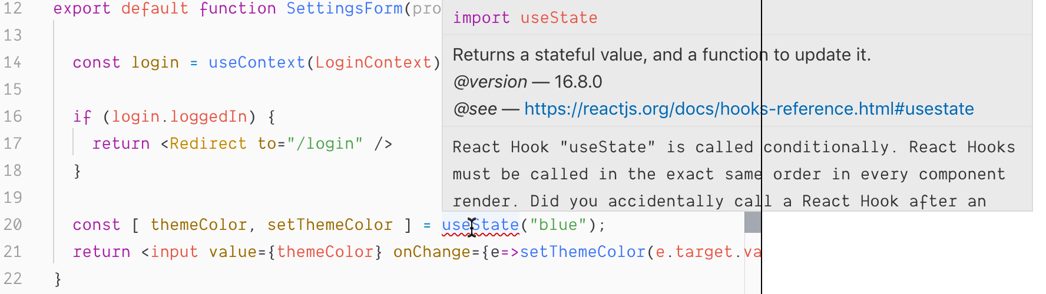
using hooks
Linter: saves us!
eslint-plugin-react-hooks is really good and helpful

Slide 39
using hooks
...and another one: useHistory from React Router
import { useHistory } from "react-router-dom";
export default function SettingsForm(props) {
function saveAndRedirect() {
saveSettings().then(
() => useHistory().push("/home")
);
}
return <•••><button onClick={saveAndRedirect}>Save</button><•••>
}
😱

Slide 40
using hooks
...this works
import { useHistory } from "react-router-dom";
export default function SettingsForm(props) {
const history = useHistory();
function saveAndRedirect() {
saveSettings().then(
() => history.push("/home")
);
}
return <•••><button onClick={saveAndRedirect}>Save</button><•••>
}
Might not be big difference, but...
☺️

Slide 41
using hooks
Might not be a big difference, but...
we may have lots of unneccessary useHistory calls (or other Hooks)
you have to know where you can use Hooks
forces you to structure your code in exactly this way
it's not "standard javascript"
Do you remember why React doesn't add a template language?
To allow us the use of our "favorite" language: JavaScript
no need to learn a new language...
Does that mean Hooks (or React) are evil?
No, but... they have their "price" (as classes have)
It's "rethinking" again

Slide 42
of using Hooks
Consequences
Notes:
Bevor wir uns mit React beschäftigen, ein kurzer Hintergrund zum Thema Single-Page-Anwendungen.

Slide 43
Consequences
Can Custom Hooks replace existing patterns?
Custom Hooks are another way for reusable logic
HOCs?
Render Properties?
Would be good imho
esp. HOCs hard to understand
But...

Slide 44
Consequences
Example: React Router withRouter HOC
import { withRouter } from "react-router-dom";
function SettingsForm( { history } ) {
function saveAndRedirect() {
saveSettings().then( () => history.push("/home") );
}
return <•••><button onClick={saveAndRedirect}>Save</button><•••>
}
export default withRouter(SettingsForm);

Slide 45
A look at the api
Example: React Router useHistory Custom Hook
import { useHistory } from "react-router-dom";
export default function SettingsForm( props ) {
const history = useHistory();
function saveAndRedirect() {
saveSettings().then( () => history.push("/home") );
}
return <•••><button onClick={saveAndRedirect}>Save</button><•••>
}
Difference:
Only one component (vs SettingsForm and HOC'd SettingsForm)
SettingsForm "knows" about Router, it's not "just a prop" anymore

Slide 46
A look at the api
Another one: React Router (with render prop)
// App.js
<Route path="/settings/:id"
render={({match}) => <SettingsForm settingsId={match.params.id} />
// SettingsForm.js
export default function SettingsForm( {settingsId} ) {
// do something with settingsId
return •••;
}
Noteable:
SettingsForm does not know anything about Router
Routing "Logic" (Params, Routes, ...) are at one place (good imho)

Slide 47
A look at the api
Another one: React Router with new Route API and useParams
// App.js
<Route path="/settings/:id"><SettingsForm /></Route>
new Router
5.2 API
no render prop anymore!

Slide 48
A look at the api
Another one: React Router with new Route API and useParams
// App.js
<Route path="/settings/:id"><SettingsForm /></Route>
// SettingsForm.js
import { useParams } from "react-router-dom";
export default function SettingsForm( ) {
const { settingsId } = useParams();
// do something with settingsId
return •••;
}
Noteable:
SettingsForm knows about Router API and Routing "Logic" (which Params)
What about "Colocation"?
new Router
5.2 API
no render-Prop anymore
(credits: https://twitter.com/andrewgreenh/status/1177213442710745091?s=20)

Slide 49
A look at the api
What about this one? (from: https://twitter.com/Wolverineks/status/1177818104048472065)
function RouterContext({ children }) {
return children({
history: useHistory(),
params: useParams(),
...
});
}

Slide 50
A look at the api
What about this one? (from: https://twitter.com/Wolverineks/status/1177818104048472065)
function RouterContext({ children }) {
return children({
history: useHistory(),
params: useParams(),
...
});
}
<Route path="/settings/:id">
<RouterContext>
{({ params }) => <SettingsForm settingsId={params.id} />
</RouterContext>
</Router>

Slide 51

A look at the api
What about this one? (from: https://twitter.com/Wolverineks/status/1177818104048472065)
function RouterContext({ children }) {
return children({
history: useHistory(),
params: useParams(),
...
});
}
<Route path="/settings/:id">
<RouterContext>
{({ params }) => <SettingsForm settingsId={params.id} />
</RouterContext>
</Router>
Noteable: welcome back, render properties!

Slide 52
Consequences
What does that mean?
Hooks provide new ways for structuring code, architecture etc
But they come with a price
nothing comes for free, nothing special here
We probably we will see new patterns, best-practices evolving
React development won't become boring

Slide 53
A look at the api
Example: Redux useDispatch and useSelector instead of connect
import { useDispatch, useSelector } from "react-redux";
export default function SettingsForm(props) {
const favColor = useSelector(state => state.theme.favColor);
const dispatch = useDispatch();
const setNewColor = (r,g,b) => dispatch(actions.setNewColor(r,g,b));
return <•••><ColorPicker onSet={setNewColor}/><•••>
}

Slide 54
A look at the api
Example: Redux useDispatch and useSelector instead of connect
import { useDispatch, useSelector } from "react-redux";
export default function SettingsForm(props) {
const favColor = useSelector(state => state.theme.favColor);
const dispatch = useDispatch();
const setNewColor = (r,g,b) => dispatch(actions.setNewColor(r,g,b));
return <•••><ColorPicker onSet={setNewColor}/><•••>
}
Consequences:
We now have only one component, have seen that already
the component is bound to Redux, have seen that already

Slide 55
A look at the api
Example: Redux useDispatch and useSelector instead of connect
import { useDispatch, useSelector } from "react-redux";
export default function SettingsForm(props) {
const favColor = useSelector(state => state.theme.favColor);
const dispatch = useDispatch();
const setNewColor = (r,g,b) => dispatch(actions.setNewColor(r,g,b));
return <•••><ColorPicker onSet={setNewColor}/><•••>
}
Consequences:
We now have only one component, have seen that already
the component is bound to Redux, have seen that already
It has different rendering behaviour (not related to redux)
"forces" re-rendering of the ColorPicker component

Slide 56
A look at the api
We can fix this:
import { useDispatch, useSelector } from "react-redux";
export default function SettingsForm(props) {
const favColor = useSelector(state => state.theme.favColor);
const dispatch = useDispatch();
const setNewColor = React.useCallback(
(r,g,b) => dispatch(actions.setNewColor(r,g,b)),
[ dispatch ]
);
return <•••><ColorPicker onSet={setNewColor}/><•••>
}

Slide 57
A look at the api
We can fix this:
import { useDispatch, useSelector } from "react-redux";
export default function SettingsForm(props) {
const favColor = useSelector(state => state.theme.favColor);
const dispatch = useDispatch();
const setNewColor = React.useCallback(
(r,g,b) => dispatch(actions.setNewColor(r,g,b)),
[ dispatch ]
);
return <•••><ColorPicker onSet={setNewColor}/><•••>
}
"Nice!" (Fortunately we only have one callback function here...)
remember the dependency array?

Slide 58
A look at the api
Again: is this really a problem?
In most cases not as performance might be good enough to re-render all the time, so useCallback ist not a must
I wonder how many CPU engery is wasted due to billions of unneccessary re-renderings in React Apps world wide 🤓
But this is – esp. for Beginners – not easy to understand (call me a Beginner)

Slide 59
Consequences
Let's have a look at the component lifecycle
running' should be false until timer is started...
if you want to do it right, please read here: https://overreacted.io/making-setinterval-declarative-with-react-hooks/
export default function App() {
const [ running, setRunning] = useState(false);
useEffect( () => {
const id = setTimeout( () => setRunning(false), 500);
setRunning(true);
return () => clearTimeout(id);
}, [ running ])
return (<>Running: {running.toString()}</>);
}

Slide 60
Consequences
Let's have a look at the component lifecycle TODO USEREF
we want to cancel the request
export default function App() {
const [ running, setRunning] = useState(true);
useEffect( () => {
const id = setTimeout( () => setRunning(false), 500);
setRunning(true);
return () => clearTimeout(id);
}, [ running ])
return (<>Running: {running.toString()}</>);
}

Slide 61
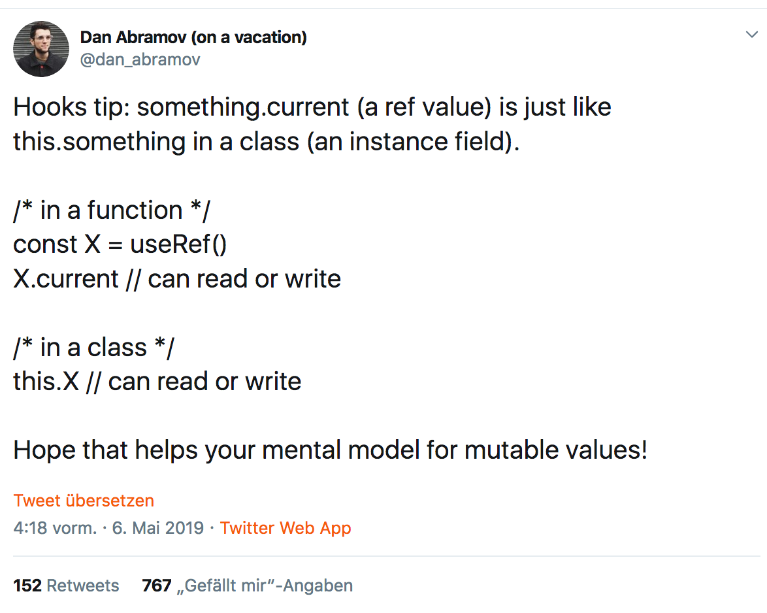
A look at the api
useRef
https://twitter.com/dan_abramov/status/1125223181701263360

Slide 62
Consequences
A look back to...
export default class App extends React.Component {
state = { running: false }
componentDidMount() {
this.interval = ...
}
componentWillUnmount() {
clearInteval(this.interval);
render() {
return <button onClick={() =>
clearInterval(this.interval)}>...</button>
}
}

Slide 63
Consequences
A look back to...
it's a class, but: clear lifecycle method
export default class App extends React.Component {
state = { running: false }
componentDidMount() {
this.interval = ...
}
componentWillUnmount() {
clearInteval(this.interval);
render() {
return <button onClick={() =>
clearInterval(this.interval)}>...</button>
}
}

Slide 64
with Hooks
TypeScript
Notes:
Bevor wir uns mit React beschäftigen, ein kurzer Hintergrund zum Thema Single-Page-Anwendungen.

Slide 65
TypeScript
Type Inference with useState works very good!
function useAppSelector<R>(fn: (state: AppState) => R): R {
return useSelector(fn)
}
export default function SettingsForm(props) {
const favColor = useAppSelector(state => state.favColor);
return •••;
}

Slide 66
TypeScript
...custom hook for typing useSelector?
function useAppSelector<R>(fn: (state: AppState) => R): R {
return useSelector(fn)
}
export default function SettingsForm(props) {
const favColor = useAppSelector(state => state.favColor);
return •••;
}

Slide 67
Summary
Summary
Hooks are kind of a new (meta-)language
they solve problems
but they raise new ones
Through new ways we even have more ways to structure our code
React was always about flexibility... some like, some don't
I don't like hypes and that's probably the real reason I'm sceptical

Slide 68
nils@nilshartmann.net
NILS HARTMANN
https://nilshartmann.net
🌻
Thanks a lot!
Slides: https://nils.buzz/react-meetup-hooks

